Slide 1
ONLINE BUSINESS MARKETING Sandesh Sapra 04135304420 Aniket Bhatnagar 00635304420

Slide 2
INTRODUCTION
This project is made because business man can grow up there business absolutely free by advertising and cut the advertising cost.
Every small seller can sell their products outside their area.
It can be used to target large customers via this project
It will help to grow up their business
Helps to cut down the advertisement cost

Slide 3
PROJECT OVERVIEW
It provides a framework to their users to show-up their business.
Different users from different country can register themselves
They can show their business to the whole world
Provides platform to connect with people
They can grow-up their business
It will allow small scale entrepreneur to advertise about their products and services. It is free of cost. The admin will verify the seller and deregister for the same if found fake.
It is simple register and login. After that, one can add products according to the categories and advertise accordingly

Slide 4
MODULES
LOGIN : In this user and admin can login with there registered username and password.
UPDATE : In this both admin and user can update there data.
DELETE : User and Admin can both delete his/her business.
SEARCH : User and Admin can both search businesses.

Slide 5
SOFTWARE USED
HTML
CSS
MYSQL
JSP

Slide 6
HARDWARE REQUIREMENTS
Intel core ™ 15-2450 M Processor 2.50GHz with turbo Boost up to3.10GHz
Windows® 10 64 bit
Memory 4GB/Hard disk Drive 500GB

Slide 7
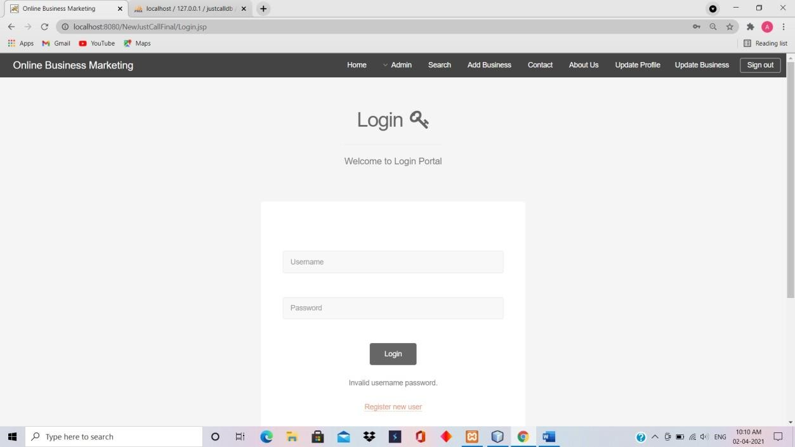
TEST CASES If the user will login with wrong username and password it will show invalid username and password.

Slide 8
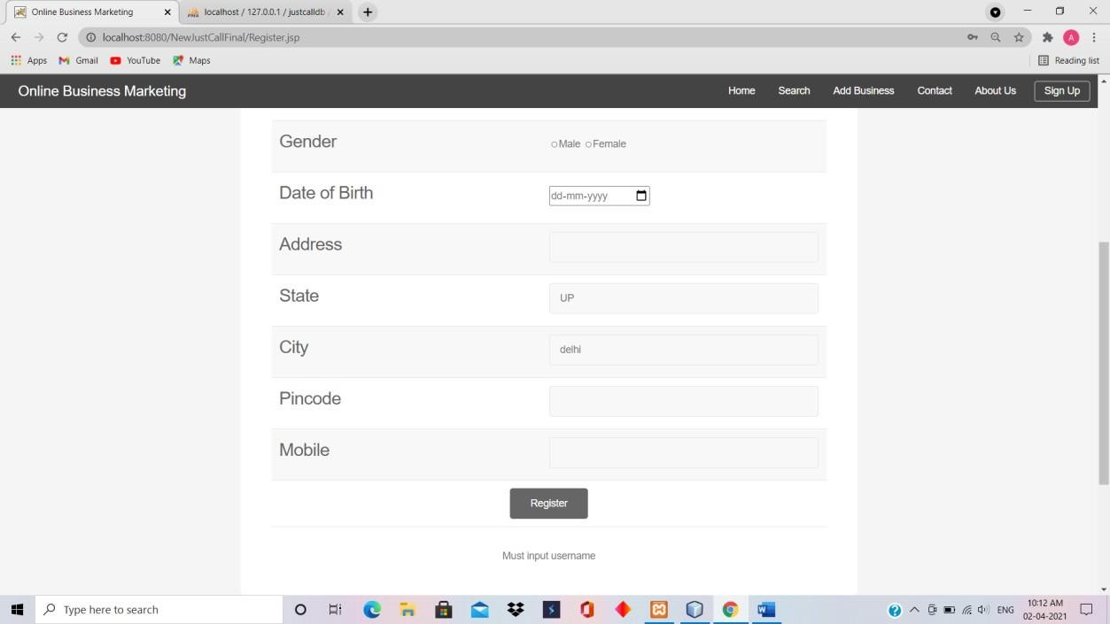
If the user forgets to put username with registeration it will show must input username.

Slide 9
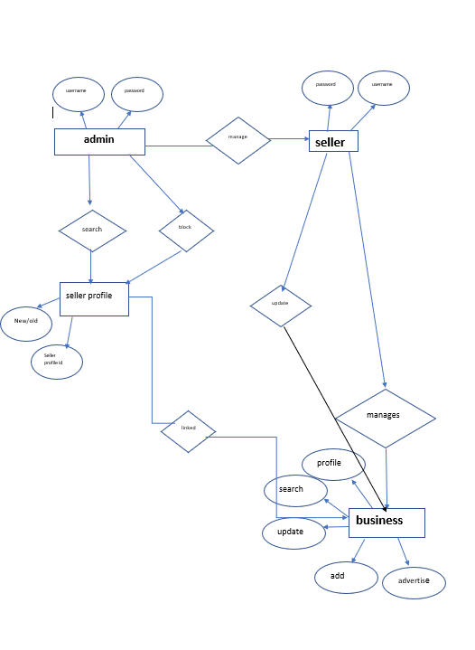
ER DIAGRAM

Slide 10
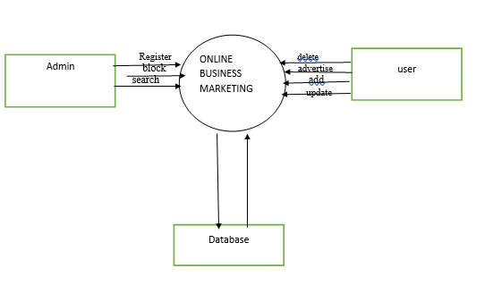
DFD LEVEL-0

Slide 11
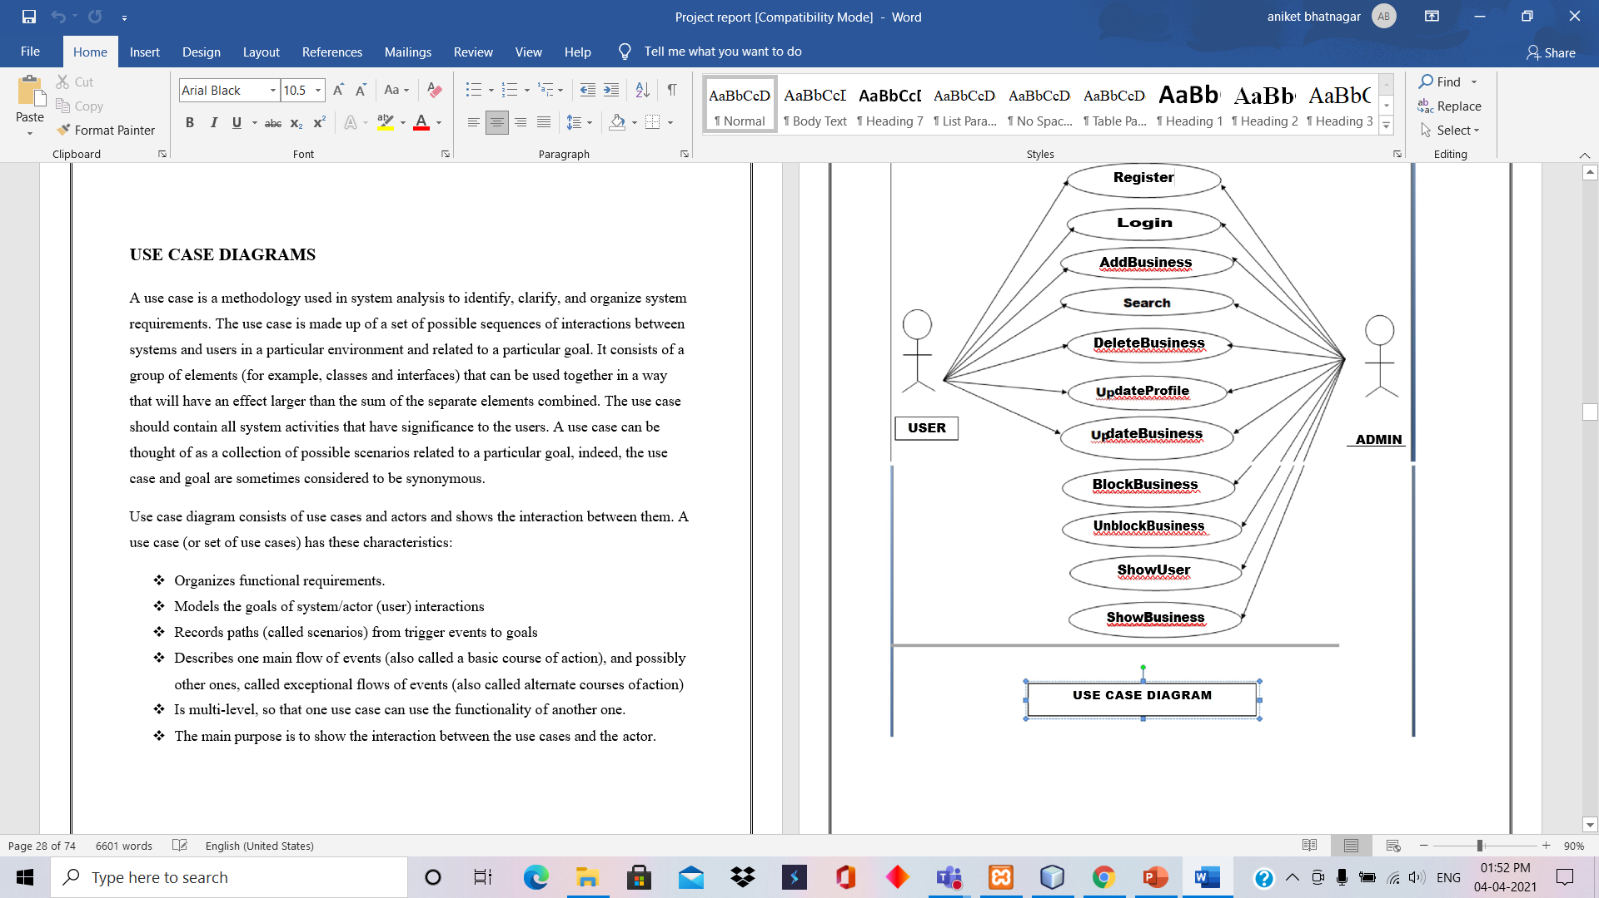
USE CASE DIAGRAM

Slide 12
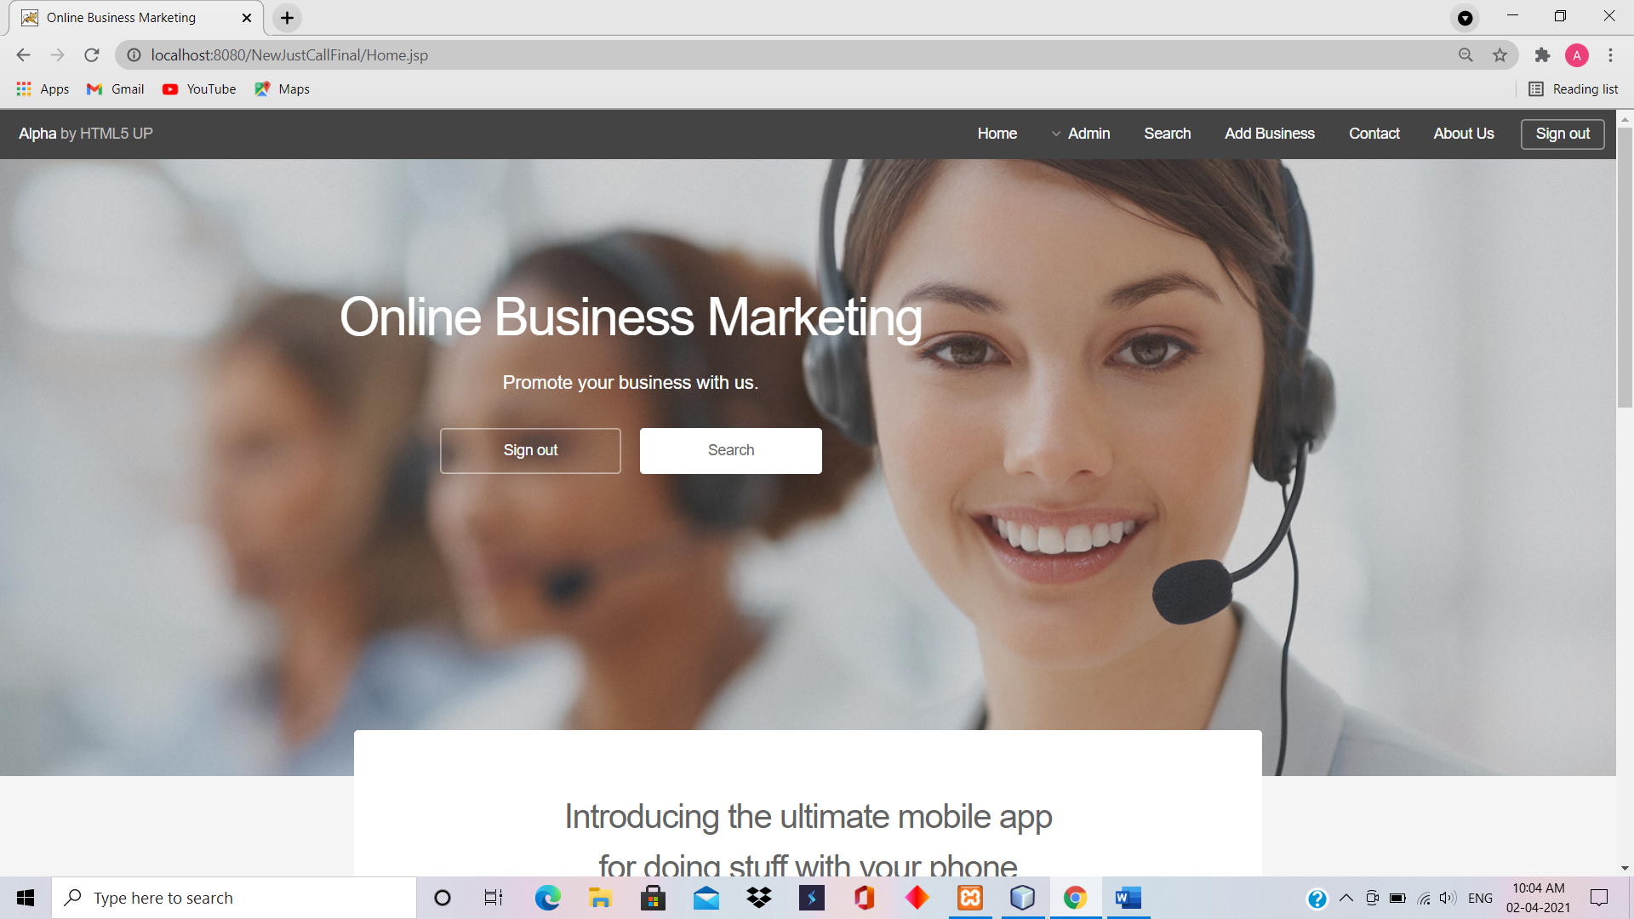
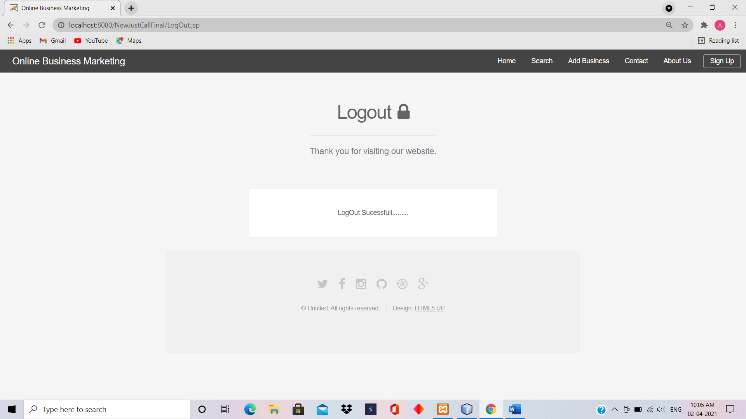
SCREENSHOTS

Slide 13
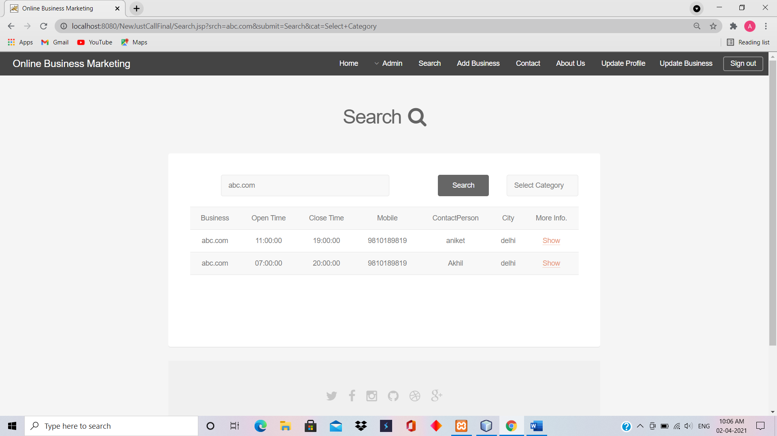
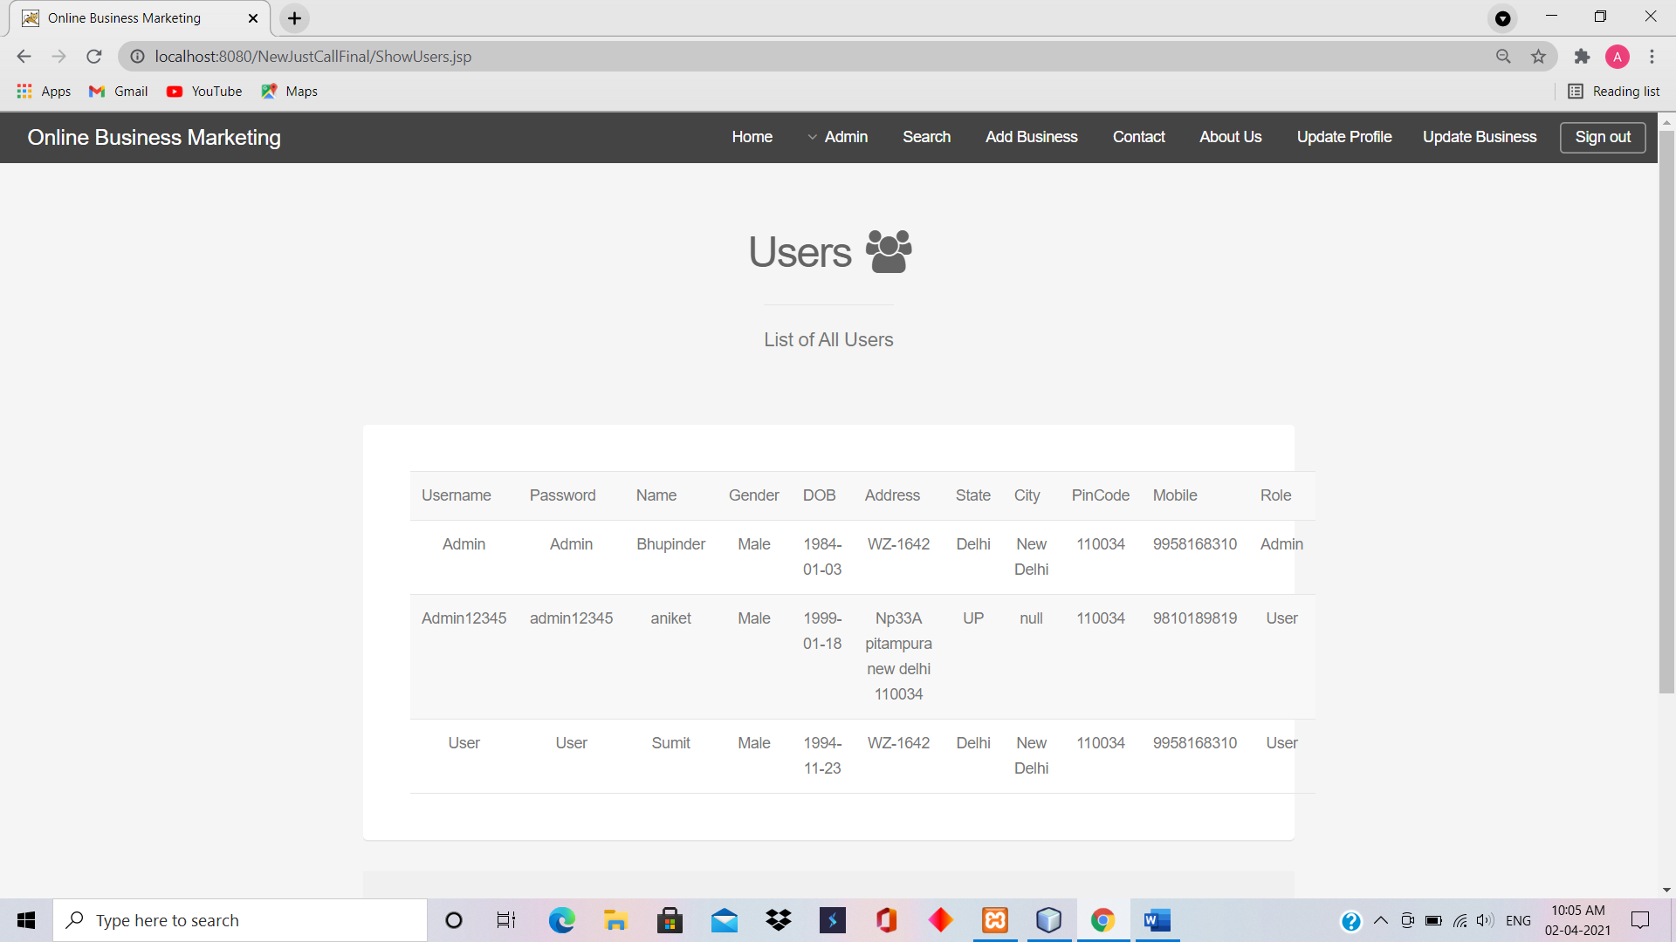
SCREENSHOTS

Slide 14
FEATURES
Application is distributed which can be accessed from different location
No, need to pay the cost for advertisement
Can add or delete products anytime without any trouble
Can be used to connect with the customers online
Can advertise any company and product

Slide 15
FUTURE SCOPE
Stock management will be there.
User can buy products.
Chatbot system will be there to help newones.
Online database management system will be used so that this application can handle large amount of data.

Slide 16
BIBLIOGRAPHY
http://www.w3schools.com
https://www.w3schools.com/css/
https://www.w3schools.com/html/
https://www.w3schools.com/java/java_intro.asp
https://www.tutorialspoint.com/jsp/index.htm
https://www.javatpoint.com/steps-to-connect-to-the-database-in-java
https://www.javatpoint.com/request-implicit-object
https://zetcode.com/db/mysqljava/

